Slide 1
Aligning People and Purpose:
A Framework for Assessing and Improving Your Talent Strategy
OUR WEBINAR WILL BEGIN SHORTLY
Notes:
[ZOE]
Hello, and on behalf of Seramount, I want give you a warm welcome before diving into today’s topic. Our webinar will begin shortly.
[SHORT PAUSE]
While you wait, take a moment to let us know where you’re dialing in from and what company, organization, or agency you are representing. Thank you and I’ll give folks another minute to join in before going over logistics.

Slide 2
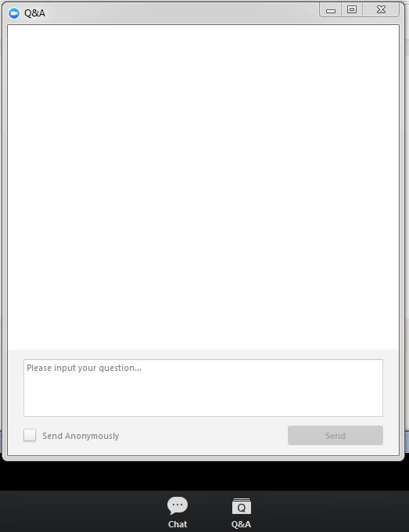


Using Zoom
Utilize the Chat Button to Add Comments Throughout the Session
Engaging in Chat
Asking a Question
Brief Exit Survey
Type your question here
We’d appreciate your feedback on today’s presentation.
Notes:
[ZOE] As folks are still dialing in, I’ll briefly go over a few logistics.
To review your audio options for this webinar, please refer to the webinar confirmation email in your inbox. You will notice the video and mic options are muted to keep the sound quality as clear as possible.
Please utilize the Chat button – located in the Zoom menu bar at the bottom of the window – to make comments throughout the session. There will be dedicated times throughout the session where we will ask for a response, but we hope that you will utilize the Chat throughout.
If you have any questions, please type them into the Q&A box. If we aren’t able to get to your question during the Q&A portion at the end of this webinar, a member of our team will follow up with you directly afterwards. We will also be sending slides out to everyone who registered for this event via email.
At the end of this webinar, a brief exit survey will appear in your browser, where you can let us know your thoughts about today’s content. We’d greatly appreciate your feedback!

Slide 3
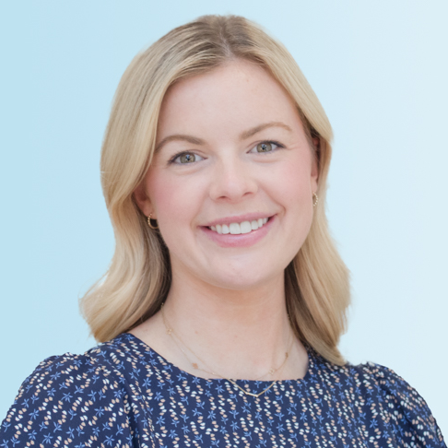


Meet Your Presenters
Staff portrait location:
https://eab.box.com/v/EAB-Portraits
Zoe Burrow
Director,
Partner Development, Seramount
Zsofia Duarte
Director,
Consulting, Seramount
Rumbi Petrozzello
Head of Strategy,
Consulting, Seramount
Notes:
[ZOE] My name is Zoe Burrow (she/her pronouns) (give visual description of yourself – hair color, eye color, what you are wearing, description of the space you are in) For those unfamiliar with this practice, that was a visual description for those attending from the blind or low vision communities to be more inclusive of their experience.
I am a Director of Partner Development here at Seramount, I work closely with organizations looking to __ to ultimately create more inclusive workplaces. I'm happy to introduce my colleagues, who will tell you a little about their roles here at Seramount.
[RUMBI] Hi everyone, I am Rumbi Petrozzello (she/her pronouns) (give visual description of yourself – hair color, eye color, what you are wearing, description of the space you are in). I am the Head of Strategy for the Consulting team here at Seramount, I help organizations ___ to tackle complex workplace culture and talent challenges.
[ZSOFIA] Hi everyone, I am Zsofia Duarte (she/her pronouns) (give visual description of yourself – hair color, eye color, what you are wearing, description of the space you are in). I am a Director of Consulting here at Seramount, I help organizations ___ to tackle complex workplace culture and talent challenges.

Slide 4
roadmap
The Current State of Long-Term Progress on Talent Objectives
1
2
Moving From a Selective to an Informed Talent Strategy
3
A New Approach to Employee Listening
Notes:
Rumbi

Slide 5
Long-Term Progress on Talent Objectives is Rare
The Current State of Long-Term Progress on Talent Objectives
Reactionary Initiatives Prove to be Insufficient
Only 1.3%
<2 years
47%
Increase in people of color in corporate America
Average tenure of a Chief Diversity Officer
of employees report feeling “less than”
.3%
30%
Only 20%
Decrease in women in corporate America
of employees don’t feel they will be able to advance at their current company
of employees say that leadership communicates effectively with those who are different
As I watched the training unfold, I realized the topic areas were far too generic. Not a single leader was going to leave that training with actionable DEI solutions around the organization’s known employee success drivers."
-Chief Diversity Officer
Source: Gallup, Harvard Business Review, Wellable
Notes:
Rumbi to share…
With increased attention to social issues in the last few years, both in the U.S. and globally, organizations have given diversity, equity, and inclusion (DEI) increased attention—both positively and negatively. This attention has come in the form of public statements, budget adjustments, and monetary investments. Many organizational leaders seem genuinely disheartened by domestic and international inequities and personally moved to investigate and remedy those present in their workplaces.
Throughout our 40+ years of research, advisory, and consulting at Seramount, we have watched senior leaders be quick to throw money—at times up to millions—at their DEI challenges. And since 2020, this tendency to invest in a reactionary, rather than informed way, has only increased. Leaders are funding popularized and “quick fix” DEI solutions rather than stepping back to strategically address the root causes of their "DEI problems.”
The quote on the bottom is from a CDO partner who implemented an unconscious bias training after the murder of George Floyd, just because he felt it was imperative to do something.

Slide 6




Why Are Talent Initiatives Consistently Failing?
The Current State of Long-Term Progress on Talent Objectives
Pressure to Act Swiftly Leaves Little or No Time for Listening to Employees
“House on Fire” Issues
Societal issues, news cycles, consumer pressures, etc.
Aiming To Be Legally Compliant
Fear of being sued, laws and regulations, etc.
HR Professionals or Fire Fighters?
Problems Presenting in Your Data
Guesswork initiatives to solve for high attrition, low retention, disengagement, etc.
Notes:
Rumbi to share…
Because so few organizations listen to their employees to learn the root causes of organizational talent issues, there is often pressure from all sides to take immediate action and provide immediate solutions. This means there is simply no time to hear about the employee experience to learn why certain talent challenges are showing up in data. Resultingly, few organizations know what they are solving for, so the initiatives that they are implementing becomes guess-work.
Many DEI efforts to advance talent objectives and improve the employee experience are taken in response to an immediate or perceived need. They are often either risk-driven (fear of being sued and/or not following laws and regulations) or initiative-driven (desire to do something along with a mere guess at what will work) and therefore, do not have an impact. These risk-driven or initiative-driven DEI efforts are often short-term projects owned exclusively by CDOs to respond to immediate or perceived need. It is still the exception rather than the norm for organizations to listen to, learn from, and map out the employee experience to inform talent objectives.

Slide 7
roadmap
1
The Current State of Long-Term Progress on Talent Objectives
Moving From a Selective to an Informed Talent Strategy
2
3
A New Approach to Employee Listening
Notes:
Zsofia to share…
Thank you, Rumbi, for setting the stage for the next portion of our program where we’ll be diving into the Talent Strategy Maturity Model.

Slide 8

Employee Listening is Key to Data Collection
Moving From a Selective to Informed Talent Strategy
Selective Strategy
Informed Strategy
Reactively offering programs and initiatives without developing an informed strategy to drive meaningful change
Proactively targeting efforts to meaningfully enhance employees’ experience and well-being through known drivers
Three Pillars of an Informed Talent Strategy
1
Strategic Objective-Led
2
3
Culturally Embedded
Leadership-Led
Programs and solutions are strategically focused on making progress on a defined set of known employee success drivers
Aligned leaders drive progress on a defined set of known drivers of employee success in coordination with programming
The organization’s systems and culture (values, attitudes, and beliefs) create an inclusive and equitable work environment for all
Notes:
Zsofia to share…
When our partners come to us with a set of challenges that may be presenting in their data, we’ve realized a pattern in the fact that these challenges are often the result of what we have coined a “selective strategy.” This is when organizations are reactively offering programs and initiatives without developing an informed strategy to drive meaningful change. Rumbi mentioned a few examples of these sorts of initiatives earlier when she was talking about those ”quick fix” reactions to house on fire issues, aiming to be legally compliant, or trying to appease senior leadership by coming up with quick solutions to problems presenting in your data.
Our goal is to provide our partners with the right employee listening tools to help them move to an informed strategy. This means that you are proactively targeting efforts to meaningfully enhance your employees’ experience and well-being through known drivers.
----
For effective and long-term progress on talent objectives, organizations must leverage best-practice research AND listen to their employees. By listening to employees to get at root cause, organizations can develop an informed talent strategy, where employee insights inform what talent best practices you deploy in your organization.
We’ve identified three pillars that define and advance an informed talent strategy: strategic objectives-led, leadership-led, and culturally embedded. Best practice talent strategies are informed by strategic objectives (rather than hypothesized needs), are cascaded to all business function leaders to be leadership-led, and then scaled to become an organization-wide culturally-embedded business imperative.
Strategic Objectives Led: DEI solutions on the employee experience must be strategically focused on making progress on a defined set of known drivers of employee success.
Example: One CDO knew their turnover rate for female middle managers, but they do not know why their middle managers were leaving. They did not know the root cause. As a result, they were guessing the solution. This leader came to us after they had been trying, unsuccessfully, to advance their DEI talent objectives and build a retention strategy only around their lagging indicators, or the turnover rate.
Most organizations listen through engagement surveys or traditional focus groups, but those alone are unable to capture true leading indicators. Instead, you need to listen to employees in a way that offers complete anonymity and psychological safety as well as captures both qualitative and quantitative data.
Leadership-Led: Aligned leaders must drive progress on the defined set of known drivers of employee success, or the strategic objectives on the employee experience. Leaders set the tone at the top and shape the culture of an organization. As a result, they determine the day-to-day employee experience. If leaders are not driving progress on a defined set of known drivers of employee success, how can anyone believe that anything will be done to improve the employee experience? When all leaders drive DEI progress, and especially the talent objectives, DEI can become an integral part of the organization’s culture.
Culturally-Embedded: Organizational culture shapes and informs individual employee behavior, both good and bad. For a work environment to shape employees to behave inclusively, the workplace culture must be one that drives and rewards equitable employee experiences, at the individual employee behavioral level. The workplace culture must be one in which every individual, from senior leadership to junior employees, are responsible for diverse, equitable, and inclusive values, attitudes, and beliefs and advancing DEI talent objectives, rather than leaving the responsibility to a separate team or department.

Slide 9




Seramount’s Talent Strategy Maturity Model
Moving From a Selective to Informed Talent Strategy
Most Organizations Don’t Have the Data Needed to Get Past Stage Two
Selective Strategy
Informed Strategy
Reactively implementing programs and initiatives
Proactively targeting efforts to meaningfully enhance employees’ experience and well-being through known drivers
1
2
3
4
5
Risk Driven
Initiative
Driven
Strategic Objective Led
Leadership Led
Culturally Embedded
Efforts meet minimal requirements to be legally compliant
Programmatic solutions or initiatives rise from immediate or perceived need either among leaders or employee groups
Programs and solutions are strategically focused on making progress on a defined set of known drivers of employee success
Aligned leaders drive progress on defined set of known drivers of employee success in coordination with programming
The organization’s systems and culture (values, attitudes, and beliefs) create an inclusive and equitable work environment for all.
Notes:
Rumbi to share…
Risk Driven:
What You Experience: Legal has a heavy hand in all DEI initiatives, as all efforts are driven by: (a) resolving existing complaints, (b) fear of future complains, and/or (c) public disclosure requirements
Initiative Driven:
What You Experience: DEI initiatives occur ad hoc reacting to (a) requests from senior leaders with passion projects, (b) demands from a collection of employees, and/or (c) impact from an external socio-political demand or movement
Strategic Objective Led:
What You Do: Formally listen to your employees, analyze employee listening data to learn their employee experience, choose which employee metrics you want to action on, and create your evidence-based action plan
What You Observe: Employees feel heard and like valuable stakeholders, DEI programming has impact on the employee experience, and DEI council have metric-driven goals
Leadership Led:
What You Do: Strategically distribute your evidence-based action plan to all organizational leaders and engage them in strategy activation for them to (a) understand the leading indicators for change and (b) understand their unique role in creating and sustaining progress
What You Observe: All leaders are aligned in solving the same problem and following the same evidence-based action plan; The CDO and corresponding team no longer own 100% of DEI talent strategy work but rather advise on all leaders’ DEI work
Culturally Embedded:
What You Do: Strategically distribute your evidence-based action plan to the entire organization and engage them in strategy activation for them to (a) understand the leading indicators for change, (b) understand their unique role in creating and sustaining progress, and (c) understand the accountability mechanisms for sustaining progress; Strategically engage in continual year-over-year employee listening to inform evidence-based plans
What You Observe: Role of the CDO and corresponding team shifts dramatically to exclusively provide strategic guidance to doers across the entire organization and support continual, progressive year-over-year listening efforts
And now I’m so excited to pass things over to Rumbi to lead us through our panel discussion with who amazing partners that we have worked with to help them move from a selective strategy to an informed strategy within this DEI maturity model…

Slide 10



Please download and install the Slido app on all computers you use
With respect to the Seramount Talent Strategy Maturity Model, where does your organization rank?
ⓘ Start presenting to display the poll results on this slide.
Notes:
Rumbi

Slide 11
Crucial Questions When Beginning Your Journey
Moving From a Selective to Informed Talent Strategy
Current
State
Leaders Should Investigate These 5 Areas When Building a Talent Strategy
Effort
What do you know about your employee experience, especially across lines of difference,
from representation data, engagement data, previous assessment data, etc.?
Are there any stubborn culture problems that you have tried to solve but have not been able to? Are you able to properly isolate the cause of the problem?
Motivation
Leadership
Alignment
Ownership
Are talent and culture initiatives driven by legal precedent or momentary special interests of leaders or by a strategic plan to make progress on a defined set of known drivers of employee success?
Does your senior leadership team understand the talent and culture goals and are they motivated to take action, or are they looking to the CHRO, CTO, or CDO to make all the change?
Who owns and drives your talent and culture strategies? Is it the CHRO, CTO, CDO, or is it embedded across the organization? What is the corresponding accountability measurement structure?
Notes:
Rumbi to share…

Slide 12
roadmap
1
The Current State of Long-Term Progress on Talent Objectives
2
Moving From a Selective to an Informed Talent Strategy
3
A New Approach to Employee Listening
Notes:
Zsofia to share…
Thank you, Rumbi!
And for the final portion of our program, we’ll be talking about how some of these concepts have been brought to life at our client organizations.

Slide 13
Standard Diagnostic Tools
Developing a Successful Talent Strategy
Are necessary, but not sufficient
 | Engagement Surveys | Focus Groups
Anonymity | Uncertain anonymity | Not anonymous
Completeness of Methodology | Quantitative | Qualitative
Depth of Insight | Low: You get what you get/inability to follow-up | Low: Inability to collect quantitative data
Reach | Wide Reach | Narrow Reach
Personalization | Cannot personalize | Can personalize, but cannot scale
Remote/Hybrid Work Friendliness | Participation from any location | Limited to one location due to facilitation needs
Does the Intelligence Scale? | No; surface level questions for broad audience | No; hard/inefficient to scale
Synthesis and Insight Generation | Heavy lift by talent teams; hard to disseminate and act on | Synthesis possible but anonymity and scale limitations dampen impact
Notes:
Zsofia to share…
How do you all feel about engagement surveys and focus groups and share why? Let’s get a few brave volunteers!

Slide 14
Increase Talent Teams’ Agility and Accuracy
Developing a Successful Talent Strategy
Through Employee Voice SessionsSM
 | Engagement Surveys | Focus Groups | Seramount Employee Voice Sessions (EVS)
Anonymity | Uncertain anonymity | Not anonymous | Complete anonymity, provides psychologically safe environment
Completeness of Methodology | Quantitative | Qualitative | Quantitative and Qualitative with Thematic Findings
Depth of Insight | Low: You get what you get/inability to follow-up | Low: Inability to collect quantitative data | Live moderation and facilitation for “second order questions”
Reach | Wide Reach | Narrow Reach | Wide Reach
Personalization | Cannot personalize | Can personalize, but cannot scale | Personalization at scale possible
Remote/Hybrid Work Friendliness | Participation from any location | Limited to one location due to facilitation needs | Participation from any location with remote facilitator
Does the Intelligence Scale? | No; surface level questions for broad audience | No; hard/inefficient to scale | Scales easily
Synthesis and Insight Generation | Heavy lift by talent teams; hard to disseminate and act on | Synthesis possible but anonymity and scale limitations dampen impact | Executive reports and synthesis driving to actionable intelligence
Notes:
ZOE to share…
There are two areas I want to highlight about EVS different kind of listening.
The first is anonymity, which is so critical in getting truly unfiltered insight into your employee’s experience.
Unlike focus groups that are not anonymous and engagement survey’s that are perceived as not anonymous, EVS offer complete anonymity so employees feel entirely safe to share their answers honestly.
We do this through a novel process that we have of assigning anonymous usernames to employee employees as they login. So, employees are known as anon123 or anon567 in the focus group and they can truly tell us what they need to succeed or how they experience inclusion or exclusion
Second is the level of insight that you get from EVS tool.
Because EVS is live moderated, the facilitator can ask follow up questions and get to the “why’s” behind the answers.
The last incredibly important feature is that there is live moderation and conversation on the focus group, allowing us to really dig deeper.

Slide 15



Talent Intelligence Fuels Intentional Initiatives
Assess360’s Three-Part Solution to Drive Measurable and Sustainable Change
Employee Voice
Sessions (EVS)
Comprehensive Data
Expert Talent Consultants
Anonymous, online
focus groups moderated
by our experts
Gather rich, qualitative data that breathes life behind the numbers
Paint an authentic picture of the employee experience
Provide a comprehensive, digestible view of Assess360 findings
Nuanced picture of current state and strategic gaps
Make data easy to share and explain to stakeholders
DEI and Talent professionals with decades of experience
Guide you through stakeholder alignment and data-driven decision-making
Instill confidence in you
and your inclusion strategy
Listen Differently
To accurately diagnose your pockets of disengagement
Monitor Regularly
To capture changes in employee sentiment on the culture and their experience
Act Intentionally
To deploy proven practices that re-engage employees
Notes:
[ZOE]
We know that these challenges are difficult and it’s hard to know what to do that address challenges that show up in an engagement survey. That is why Seramount has developed Assess360, a three-part solution that provides data and intelligence to empower intentional talent initiatives.
Here’s our three part solution to sustainable culture change.
Let’s start with EVS: This is the insight engine John just discussed. Employee Voice Sessions are anonymous, online focus groups that gather rich, qualitative data from your employees to paint an authentic picture of your employee experience.
Next, our comprehensive data makes it easy to share, measure and track findings year over year. The dashboards in our portal provide a comprehensive, digestible view of your Assess360 findings, allowing you to measure and track your return on investment and making your data easy to share and explain to your stakeholders.
Finally, our expert consultants with decades of experience are able to interpret EVS feedback, guide you through decision making and building roadmaps. They are with you every step of the way, from ensuring stakeholder alignment at the start of the project, through data-driven decision making once you receive your results.

Slide 16




How Can Seramount Help Your Organization?
We value your feedback.
Please share your thoughts about our presentation in the short poll on your screen.
Thank you!
Let us know if you’re interested in…
Scheduling a call to learn about our approach to employee listening.
Receiving a copy of our guide to The Five Stages of Talent Strategy Maturity.
Something else? Choose this option and we will follow up with you.
Notes:
[ZOE]
Poll 1: Before we sign off today, we have another poll to get your input about today’s session. [MARIA M LAUNCHES POLL]
Overall Session Evaluation: Excellent, Good, Fair, or Poor
Poll 2: We’d also like to know how else we can be a resource to your team. Please choose one or more options for us to follow up with you.
Scheduling a call to learn about our approach to employee listening.
Receiving a copy of our guide to The Five Stages of Talent Strategy Maturity.
Something else? Choose this option and we will follow up with you.
Poll 3: And finally, please share any additional thoughts or questions about today’s content. We greatly appreciate your feedback as it helps inform future webinars!
Thank you for joining us today!

Slide 17



Create Stakeholder Buy-In to Drive Change
Moving From a Selective to Informed Talent Strategy
Empower Stakeholders with the Right Insights in the Right Moments
Assessment-Informed Strategy Design
Engage stakeholders and employees from day 1 by listening to their needs, priorities, and principles for change.
Stakeholder Input
Employee Feedback
Harness the momentum of your stakeholders to put your strategy into action.
Listen, learn, and map your employees’ leading indicators.
“Holding one Employee Voice Session is like conducting sixty one-on-one interviews at once. I’ve never seen another tool that can gather employee insights in such an engaging way.”
-Chief Culture Officer
Global Insurance Company
Executive Leaders
Board Members
Functional Leaders
Employee Resource Groups
Geographical Regions
Business Units
Notes:
ZSOFIA to share…
3 parts
Stakeholder 1-1s
Assessment-Informed Strategy Design
Stakeholder Alignment Sessions
The Principles of Aligned, Engaged Stakeholders
Engage them from Day 1 by listening to their needs, priorities and principles for change
Engage them in strategy activation through alignment sessions to ensure stakeholders:
Understand the leading indicators for change and the strategy for change
and
Understand and agree on their unique role creating progress

Slide 18
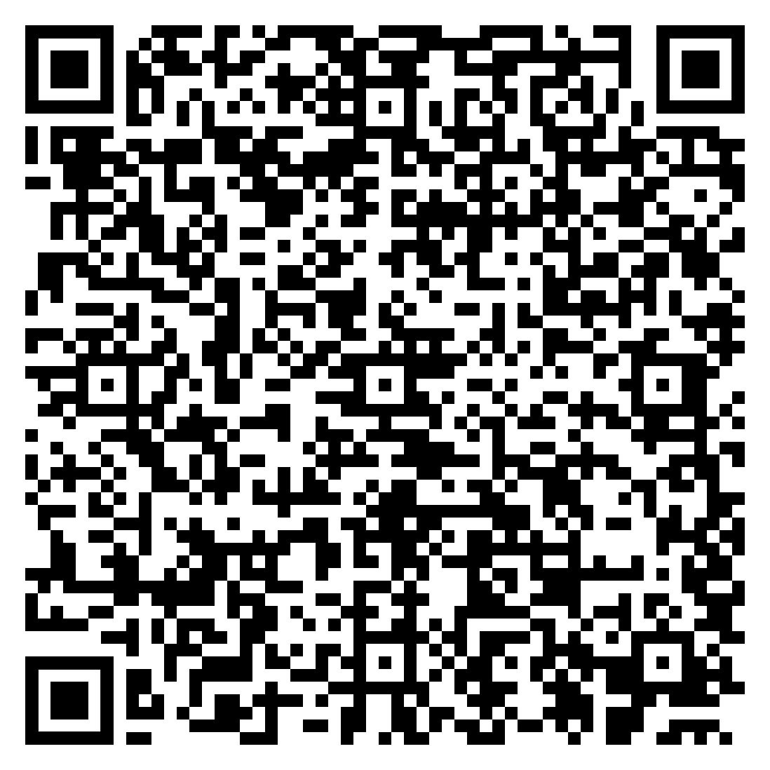


Thank You
Learn more about Seramount’s approach to creating inclusive workplaces
Connect with Us
@seramount
@seramount
Rumbi Petrozzello | Head of Strategy
Rumbi.Petrozzello@seramount.com
Zsofia Duarte | Associate Director
Zsofia.Duarte@seramount.com

Slide 19
Seramount Contact Info

Slide 20
Notes:
[ZOE]
Before we get to today’s topic, let me spend 1-2 minutes on Seramount—and introduce you to who we are, what we do, and what motivates our work.
The workplace is rapidly shifting, and talent topics are dynamic and can be difficult to lead. At Seramount, we know because we’ve been there. Our team has a 40-year track record of bringing solutions powered by insight to Talent, HR and DEI leaders.
Our aspiration now and across our history—you can see at the top of this page— is to empower inclusive and high-performing workplaces—we want to help you build strong a culture where all employees thrive.
We work with each company differently. Whether you are just beginning, going from good to great, or a recognized leader, we support your unique priorities and challenges with our comprehensive portfolio of solutions.
Now, while no two partnerships are exactly alike, we commonly work with organizations in four areas, so let me briefly share the pillars of work.
Starting on the left—
•We recently joined forces with Forage, adding a new solution that helps employers build a stronger workforce at the start of the talent lifecycle. Forage’s virtual job simulations help partners identity and hire top early career talent.
•Second, we help organizations address challenging workforce trends—like employee disengagement and attrition—through a dynamic assessment technology. Our unique methodology gives you and your stakeholders a more accurate and authentic understanding of the employee experience.
•Insight is the cornerstone of our research and advisory services pillar. With our team’s deep collective expertise and continuous in-the-market sensing, we provide guidance to support your ongoing priorities, answer your most pressing questions and build an actionable roadmap, together.
•Finally—we help our partners scale and accelerate their efforts through our research-based learning and development curriculum. Our learning pathways deliver organization-wide skill building to reinforce a culture of inclusivity at every level.
We’re very proud to work with a global network—over 600 companies of all sizes across industries and sectors including many of the Fortune 500. With each of our partners, our goal is to accelerate progress and enable lasting change in the areas that matter most to you.

